Slide 1
Chapter : Processes
By: Navjot Kaur

Slide 2
Chapter : Processes
Process Concept
Process Scheduling
Operations on Processes

Slide 3
Process
Program: Passive entity
Process is instance of a program under executing
Process – a program in execution
      Active Entity b/c it has Program Counter associated to it.
Process execution must progress in sequential manner
A process includes:
  program counter
  stack
  data section

Slide 4
Process
A process has text section/ code section.
It also includes the current activity, as represented by the value of the program counter and the contents of the processor’s registers.
A process also includes the process stack, which contains:
  temporary data (such as function parameters, return addresses, and local variables)
  data section, which contains global variables.
A process may also include a heap, which is memory that is dynamically allocated during process run time.

Slide 5
Process
A program is a passive entity, such as a file containing a list of instructions stored on disk.
A process is an active entity with a program counter specifying the next instruction to execute and a set of associated resources.

Slide 6
Process States
As a process executes, it changes state
  new: The process is being created
  ready: The process is waiting to be assigned to a processor and is ready to get executed
  running: Instructions are being executed
  waiting: The process is waiting for some event to occur/ waiting for resources
  terminated: The process has finished execution

Slide 7

Process States

Slide 8
Process Control Block (PCB)
Process Control Block (PCB, also called Task Controlling Block) is a data structure in the operating system kernel containing the information needed to manage a particular process.
The PCB is "the manifestation of a process in an operating system".

Slide 9
Process Control Block (PCB)
Information associated with each process:
1. Process State- new, ready….etc.
2. Pointer- to the parent process
3. Program Counter- next instruction to be executed.
4. Process Number- Unique identification number in OS
5. CPU Registers- Various CPU registers where process need to be stored for execution for running state.
6. CPU Scheduling Information- Process Priority and other info. required for scheduling

Slide 10
Process Control Block (PCB)
7. Memory-Management Information- Registers, Page tables (where process is saved)used by OS
8. Accounting Information- For how long CPU and other resources are allocated to process
9. I/O Status Information- List of devices allocated to the process

Slide 11
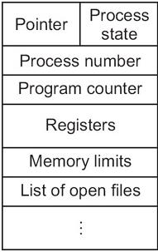
Process Control Block (PCB)

Slide 12
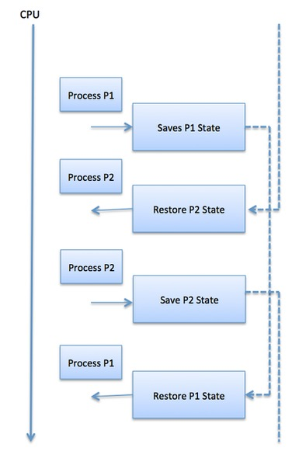
Context Switch
When CPU switches to another process, the system must save the state of the old process in the stack and load the saved state for the new process or reload the state of current process from stack.

Slide 13
Context Switch
Switching the CPU to another process requires saving the state of the old process and loading the saved state for the new process. This task is known as a context switch.
The context of a process is represented in the Process Control Block(PCB) of a process;
it includes the value of the CPU registers, the process state and memory-management information.
When a context switch occurs, the Kernel saves the context of the old process in its PCB and loads the saved context of the new process scheduled to run.

Slide 14
Context Switch
Context switch time is pure overhead, because the system does no useful work while switching.
Its speed varies from machine to machine, depending on the memory speed, the number of registers that must be copied, and the existence of special instructions(such as a single instruction to load or store all registers).
Typical speeds range from 1 to 1000 microseconds.

Slide 15

CPU Switch From Process to Process

Slide 16
Scheduling Queues
The activity of determining which process in the ready state should be moved to the running state is known as Process Scheduling.
The prime aim of the process scheduling system is:
  To keep the CPU busy all the time and to deliver minimum response time for all programs.
  For achieving this, the scheduler must apply appropriate rules for swapping processes.

Slide 17
Scheduling Queues
Schedulers fall into one of the two general categories:
Non pre-emptive scheduling: When the currently executing process gives up the CPU voluntarily.
Pre-emptive scheduling: When the operating system decides to favor another process, pre-empting the currently executing process.

Slide 18
Scheduling Queues
The process scheduling is the activity of the process manager that handles the removal of the running process from the CPU and the selection of another process on the basis of a particular strategy.

Slide 19
Scheduling Queues
The OS maintains all PCBs in Process Scheduling Queues.
The OS maintains a separate queue for each of the process states and PCBs of all processes in the same execution state are placed in the same queue.
When the state of a process is changed, its PCB is unlinked from its current queue and moved to its new state queue.

Slide 20
Process Scheduling Queues
Job queue − This queue keeps all the processes in the system.
Ready queue − This queue keeps a set of all processes residing in main memory, ready and waiting to execute.
  A new process is always put in this queue.
Device queues − The processes which are blocked due to unavailability of an I/O device constitute this queue.

Slide 21
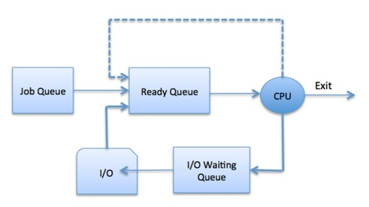
Process Scheduling Queues

Slide 22

Ready Queue And Various I/O Device Queues
Ready Queue is implemented using Linked List

Slide 23

Representation of Process Scheduling
Queuing Diagram

Slide 24
MCQ
1. CPU performance is measured through ________.
a. Throughput
b. MHz
c. Flaps
d. None of the above

Slide 25
MCQ
1. a

Slide 26
MCQ
2. Which of the following is a criterion to evaluate a scheduling algorithm?
CPU Utilization: Keep CPU utilization as high as possible
Throughput: number of processes completed per unit time
Waiting Time: Amount of time spent ready to run but not running
All of the above

Slide 27
MCQ
2. d

Slide 28
MCQ
3. _________ does the job of allocating a process to the processor.
a. Long term scheduler
b. Short term scheduler
c. Medium term scheduler
d. Dispatcher

Slide 29
MCQ
3. d

Slide 30
Schedulers
Schedulers are special system software which handle process scheduling in various ways.
Their main task is to select the jobs to be submitted into the system and to decide which process to run.
Schedulers are of three types −
Long-Term Scheduler
Short-Term Scheduler
Medium-Term Scheduler

